Slide 1
Fundamentals of Programming
Pointers

Slide 2
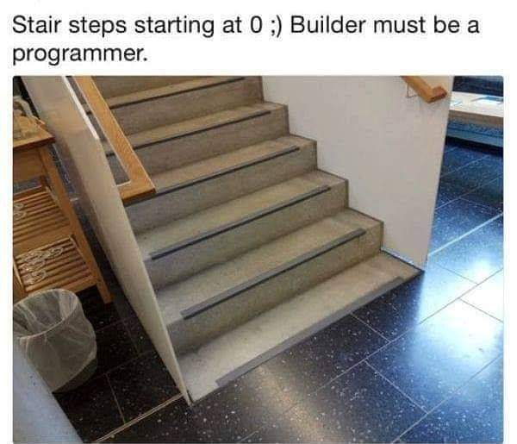

Slide 3
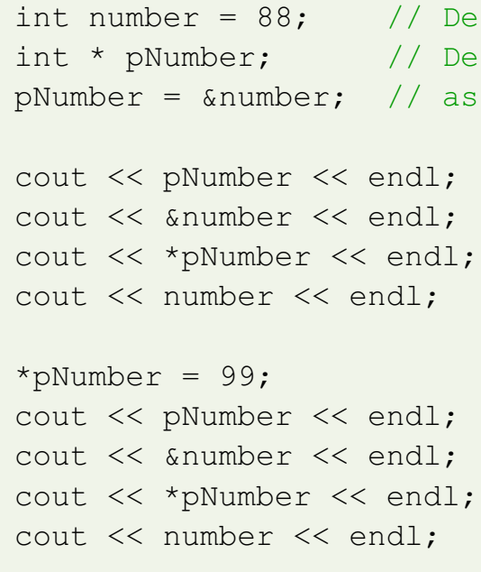
Pointers

Slide 4
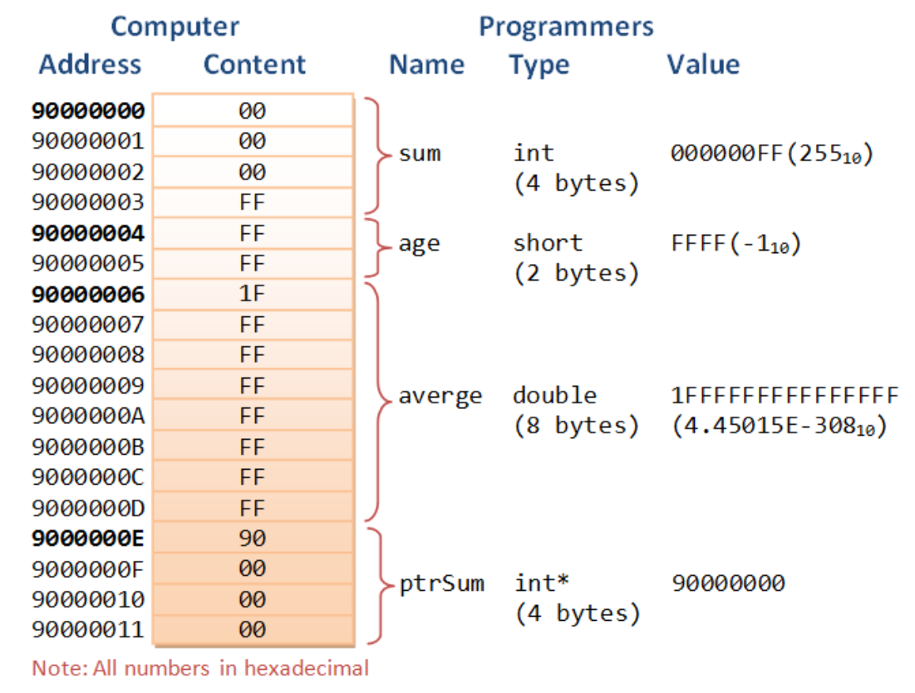

Slide 5
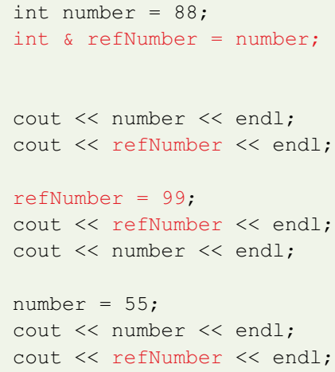
Reference Variable

Slide 6
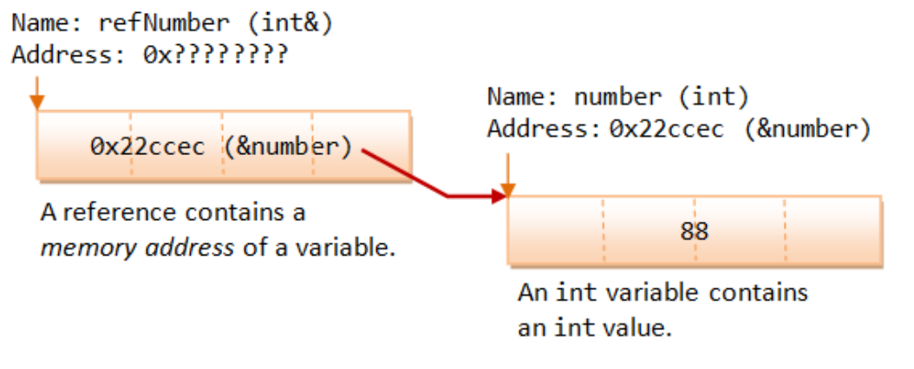
Reference Variable
A reference works as a pointer. A reference is declared as an alias of a variable. It stores the address of the variable, as illustrated:

Slide 7
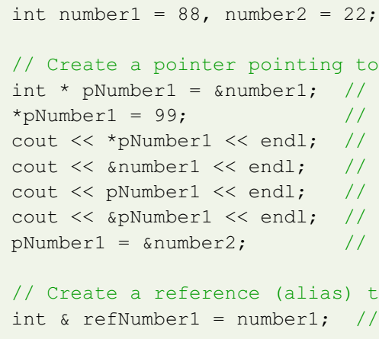
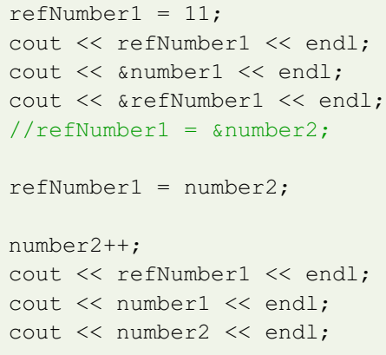
Output?

Slide 8
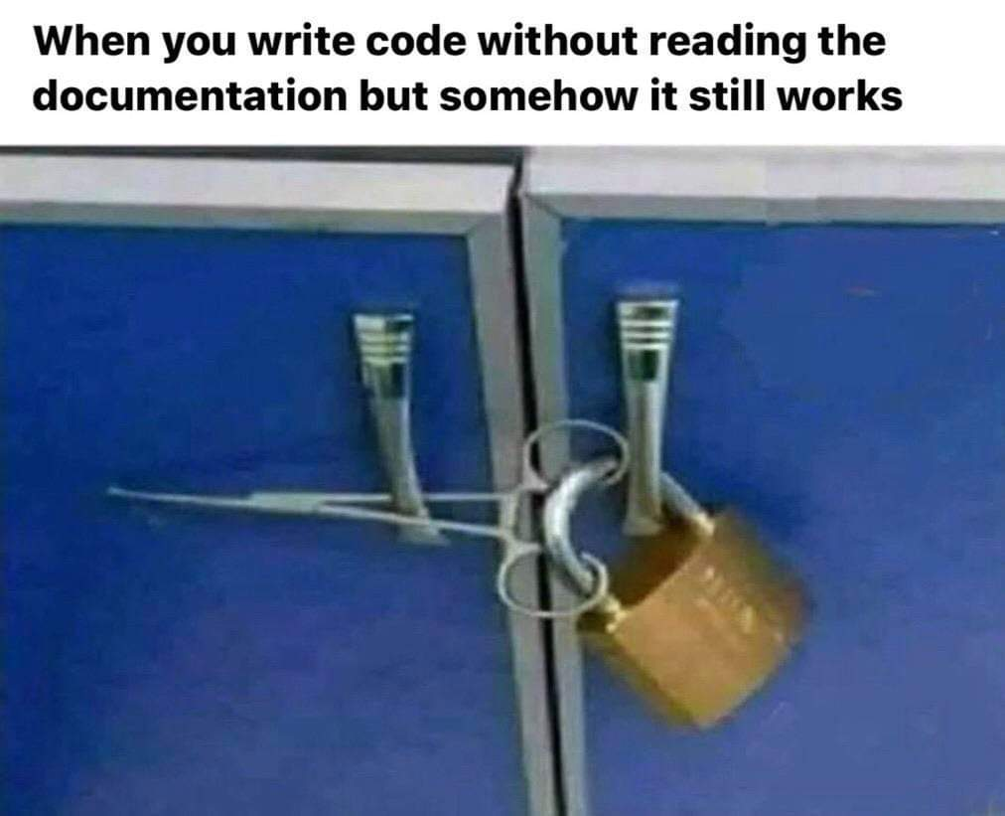

Slide 9
Pointers
int arr[] = {3,7,9,5,2};
int *p = arr;
cout << p << *p;
cout << p+1 << *p+1 << *(p+1);
int *q = p+5;
for( ; p<q; p++)
cout<< p << “ – “ << *p << endl;

Slide 10
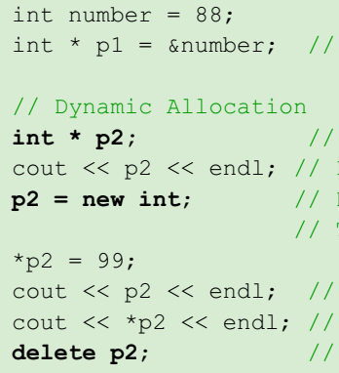
new and delete Operator

Slide 11
Static vs Dynamic
In static allocation, the compiler allocates and deallocates the storage automatically, and handle memory management. Whereas in dynamic allocation, you, as the programmer, handle the memory allocation and deallocation yourself (via new and delete operators). You have full control on the pointer addresses and their contents, as well as memory management.
Static allocated entities are manipulated through named variables. Dynamic allocated entities are handled through pointers.

Slide 12
Thanks

